Slide 1
How to learn
Inside and outside the classroom
(Slides courtesy of Prof. Grant Goodall)

Slide 2
Which of these is good advice?
As you read, highlight the important points.
Find a comfortable, quiet place to study and make that your regular place.
Master one topic completely before you move on to the next.
Identify your learning style (auditory, visual, etc.) and then use that to help you study.
Keep these in mind for now.
We’ll return to them and discuss the answers in a few minutes.

Slide 3
Getting started: A thought experiment
Your job: learn the first 20 presidents of the United States.
How will you do this?

Slide 4
A: Study the list
Study
George Washington
John Adams
Thomas Jefferson
James Madison
James Monroe
John Quincy Adams
Andrew Jackson
Martin Van Buren
William Henry Harrison
John Tyler
James K. Polk
Zachary Taylor
Millard Fillmore
Franklin Pierce
James Buchanan
Abraham Lincoln
Andrew Johnson
Ulysses S. Grant
Rutherford B. Hayes
James Garfield

Slide 5
B: Study, test, study, test
Study | Test | Study | Test
George Washington
John Adams
Thomas Jefferson
James Madison
James Monroe
John Quincy Adams
Andrew Jackson
Martin Van Buren
William Henry Harrison
John Tyler
James K. Polk
Zachary Taylor
Millard Fillmore
Franklin Pierce
James Buchanan
Abraham Lincoln
Andrew Johnson
Ulysses S. Grant
Rutherford B. Hayes
James Garfield

Slide 6
B: Study, test, study, test
Study | Test | Study | Test
_______________
_______________
_______________
_______________
_______________
_______________
_______________
_______________
_______________
_______________
_______________
_______________
_______________
_______________
_______________
_______________
_______________
_______________
_______________
_______________

Slide 7
B: Study, test, study, test
Study | Test | Study | Test
George Washington
John Adams
Thomas Jefferson
James Madison
James Monroe
John Quincy Adams
Andrew Jackson
Martin Van Buren
William Henry Harrison
John Tyler
James K. Polk
Zachary Taylor
Millard Fillmore
Franklin Pierce
James Buchanan
Abraham Lincoln
Andrew Johnson
Ulysses S. Grant
Rutherford B. Hayes
James Garfield

Slide 8
B: Study, test, study, test
Study | Test | Study | Test
_______________
_______________
_______________
_______________
_______________
_______________
_______________
_______________
_______________
_______________
_______________
_______________
_______________
_______________
_______________
_______________
_______________
_______________
_______________
_______________

Slide 9
Which way works best?
A: Use a complete list.
B: Alternate between a complete list and a blank sheet
George Washington
John Adams
Thomas Jefferson
James Madison
James Monroe
John Quincy Adams
Andrew Jackson
Martin Van Buren
William Henry Harrison
John Tyler
James K. Polk
Zachary Taylor
Millard Fillmore
Franklin Pierce
James Buchanan
Abraham Lincoln
Andrew Johnson
Ulysses S. Grant
Rutherford B. Hayes
James Garfield
_______________
_______________
_______________
_______________
_______________
_______________
_______________
_______________
_______________
_______________
_______________
_______________
_______________
_______________
_______________
_______________
_______________
_______________
_______________
_______________
Study
Study | Test | Study | Test

Slide 10
Roediger & Karpicke (2006)
Experiment 1
  Chart shows how well two groups did on tests at various points afterwards.
!

Slide 11
Roediger & Karpicke (2006)
Experiment 2
  Chart shows how 3 groups did on test at 2 points afterwards.

Slide 12
Roediger & Karpicke (2006)
!
Experiment 2
  Chart shows how much each group has forgotten after one week.

Slide 13
Which way works best?
A: Use a complete list.
B: Alternate between a complete list and a blank sheet
George Washington
John Adams
Thomas Jefferson
James Madison
James Monroe
John Quincy Adams
Andrew Jackson
Martin Van Buren
William Henry Harrison
John Tyler
James K. Polk
Zachary Taylor
Millard Fillmore
Franklin Pierce
James Buchanan
Abraham Lincoln
Andrew Johnson
Ulysses S. Grant
Rutherford B. Hayes
James Garfield
_______________
_______________
_______________
_______________
_______________
_______________
_______________
_______________
_______________
_______________
_______________
_______________
_______________
_______________
_______________
_______________
_______________
_______________
_______________
_______________
Better if you’ll take the test right away (not so realistic)
Better over longer term
Study
Study | Test | Study | Test

Slide 14
A very powerful technique
It is called retrieval practice.

Slide 15
What’s it called?
retrieval practice

Slide 16
Retrieval practice
The single most important thing you will learn here all quarter:
You should be doing retrieval practice every day and every time you study.
How?

Slide 17
When you go to class
Listen, participate, take notes, etc.
At the end of class, retrieval practice!
  In writing: Write down the main points, draw diagrams, etc.
  Speaking (to yourself or to a friend): Review the main points, give a mini-lecture, etc.
  Later on, give yourself quizzes, use flash cards, etc.
This is probably very different from what you are used to doing.

Slide 18

As you are leaving class…
The difference between the 2nd and 3rd laws of thermodynamics is that…
The old you
The new you
I’m outa here!

Slide 19
When you study
Read one section, then summarize it in your own words.
Read another section, do the same.
When you are done, do a written summary of what you have read.
  Bullet points are fine.
Or do an oral summary.
  To yourself or to a (very patient) friend.

Slide 20
Retrieval practice is very effective
You saw the evidence.
Try it yourself and you will see.
Make it part of your daily routine.
  Every time you leave class
  Every time you study
Why does this work?
  Because it takes advantage of the way that memory systems in your brain work.

Slide 21
Your memory (simplified version)
Short-term
Most new information goes here.
Purged quickly.
Long-term
Information that is important goes here.
Purged when no longer needed.
Most of what you study goes here.
How do you get it from here to here?
You want it to go here.

Slide 22
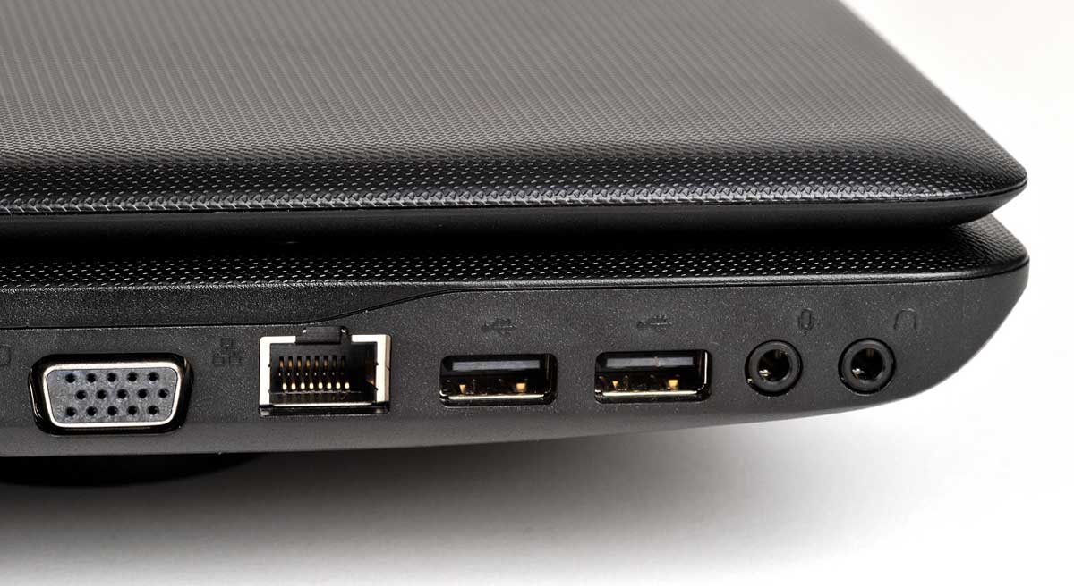
If you were a laptop…
You would have:
  RAM for short-term memory
  Hard disk for long-term memory
  Easy ways to transfer from one to the other
But you are not a laptop.
What you have is a human brain.

Slide 23
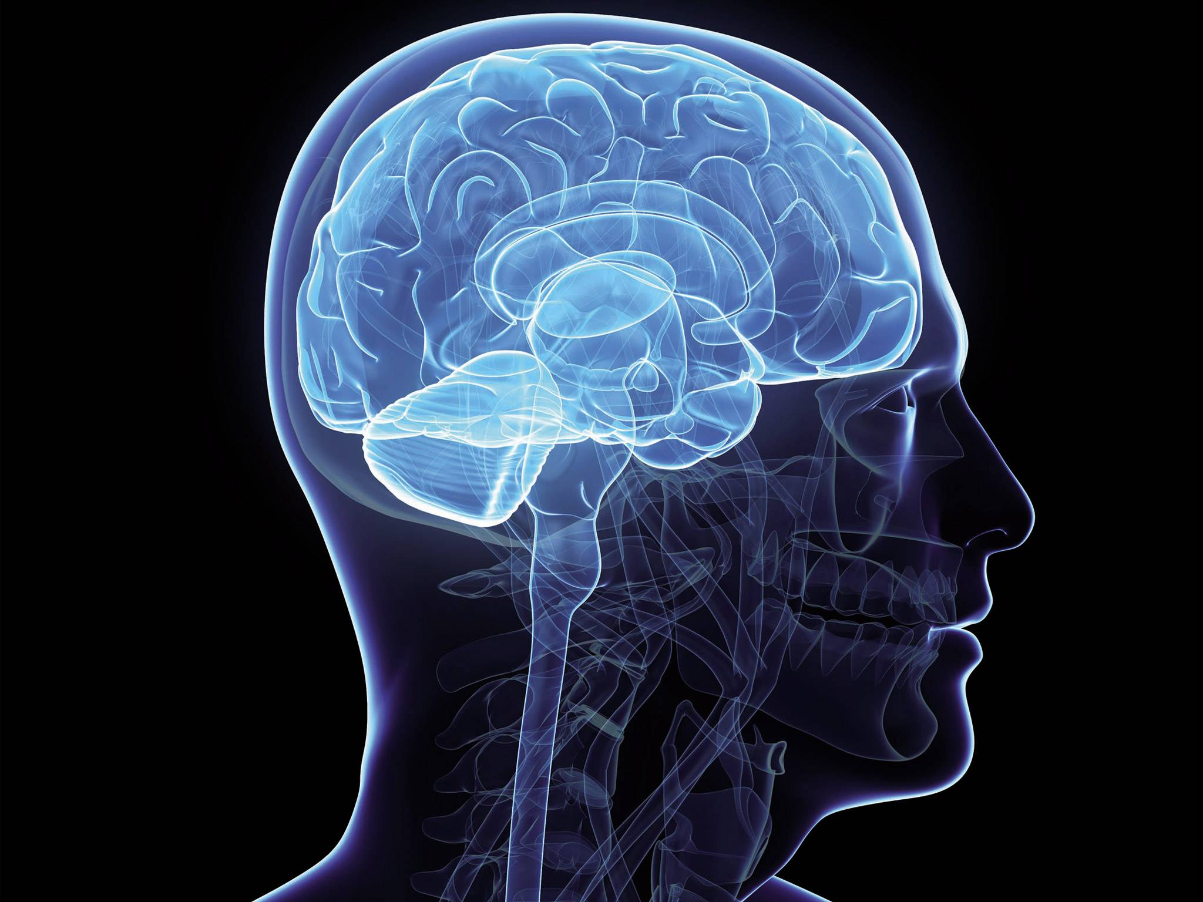
From short-term to long-term
Hm… my owner keeps trying to retrieve that information, so I guess it’s important. Maybe I should put it in long-term memory.
You brain uses behavioral cues to know what to do with memories.
This is why retrieval practice works.
It effectively tells the brain: “This information is important. Please place it in long-term memory.”

Slide 24
What else can you do? Generation.
Generation = Testing yourself before you have even seen the material.
Your brain does the best it can to “generate” the material on its own.
For example, if you’re trying to learn the first 20 presidents…

Slide 25
Start with this
_______________
_______________
_______________
_______________
_______________
_______________
_______________
_______________
_______________
_______________
_______________
_______________
_______________
_______________
_______________
_______________
_______________
_______________
_______________
_______________
Then check your answers.

Slide 26
This sounds crazy. Does it work?
You be the judge…

Slide 27
Richland, Kornell and Kao (2009)
Two groups:
  “Extended Study”: get extra time to study.
  “Test and Study”: get tested first, then study. They do badly on this test (11% correct).
Both groups had some items bolded to show what was important.
The “Test and Study” group did much better on the final test.
!

Slide 28
How could this be?!
You spend less time studying and you learn more?
You think of all the connections that you can.
  “Jefferson drafted Declaration of Independence, so he must have been one of the early presidents.”
You prepare the ground for new knowledge.
  “I know that Johnson came after Lincoln, but who came before Lincoln?”
When you do learn the answer, there is a slot for that knowledge already prepared and it has lots of connections to other things.
Memories are stronger when they have many connections to other things.

Slide 29
Difference between generation and retrieval practice?
Generation
Create a space in memory for information to come. Create many connections to rest of knowledge.
Retrieval practice
Signal to brain that the information is important by trying to retrieve it.

Slide 30
Doing both: When you go to class
Before class: Generation
Think of main questions to be addressed.
Guess what the answers might be.
Class
After class: Retrieval practice
Create an outline from memory of what was covered.
Give yourself a mini-lecture on the topic.

Slide 31
When you study
Before reading: Generation
Think of main questions to be addressed.
Guess what the answers might be.
Reading
After reading: Retrieval practice
Create an outline from memory of what was covered.
Give yourself a mini-lecture on the topic.

Slide 32
So far: Two very powerful techniques
Generation + retrieval practice
Both help get information into long-term memory.
But now a question…

Slide 33
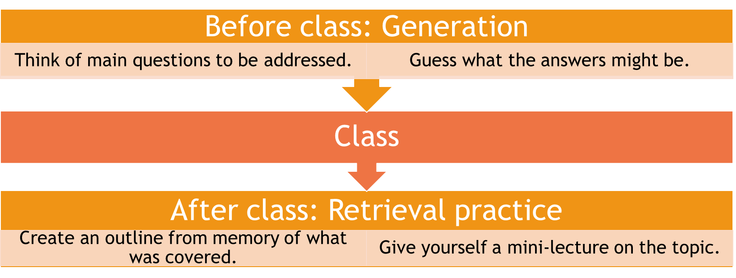
How to organize your retrieval practice time?
Is it better to do:
One long retrieval practice session?
A few shorter retrieval practice sessions, spread out over time?

Slide 34
Massed practice vs. Spaced practice
Psychologists have names for these two ways of studying:
  Massed practice: one long block of time
  Spaced practice: shorter blocks of time, spread out
Which do you think is more effective?

Slide 35

More concretely: Which group will do better?
Monday
Wednesday
Friday TEST
Monday
Wednesday
Friday TEST
Group A
Group B

Slide 36
The evidence is overwhelming
Spaced practice is better than massed practice.
In both humans and non-humans.
Has been known for over a hundred years.
There are probably many reasons for this effect.
  Spaced retrieval keeps “reminding” brain that this is important.
  Sleep plays a big role in “consolidating” knowledge.

Slide 37
How to space out your practice?
You’ll mostly be dealing with this type of scenario.
Short-term goal (test is a week from now)
  Short intervals (such as every other day)
Long-term goal (test is a year from now)
  Longer intervals (such as once a month)

Slide 38
Three very powerful techniques
Generation
Anticipate what you are going to hear or read.
Ask yourself questions about what the conclusions will be.
Retrieval practice
Write down the main points, give yourself a mini-lecture.
Lots of self-quizzing, flash cards, etc.
Spaced practice
Study for shorter periods, but at regular intervals.
Do retrieval practice every time.

Slide 39
Generation
Retrieval practice
Spaced practice
Before class
After class
Regular intervals

Slide 40
So far…
Three techniques
  Generation
  Retrieval practice
  Spaced practice
Some basic ideas about how learning and memory work.
  Connections strengthen memory.
  Retrieval strengthens memory.
  Doing these at regular intervals strengthens memory.
Let’s now return to our question from the very beginning…

Slide 41
Which of these is good advice?
Discuss!
As you read, highlight the important points.
Find a comfortable, quiet place to study and make that your regular place.
Master one topic completely before you move on to the next.
Identify your learning style (auditory, visual, etc.) and then use that to help you study.
Basic concepts about learning + memory:
  Connections strengthen memory.
  Retrieval strengthens memory.
  Doing these at regular intervals strengthens memory.

Slide 42
Which of these is good advice?
No retrieval involved.
Does not strengthen memory.
Studies show no effect.
As you read, highlight the important points.
Find a comfortable, quiet place to study and make that your regular place.
Master one topic completely before you move on to the next.
Identify your learning style (auditory, visual, etc.) and then use that to help you study.
Basic concepts about learning + memory:
  Connections strengthen memory.
  Retrieval strengthens memory.
  Doing these at regular intervals strengthens memory.

Slide 43
Which of these is good advice?
As you read, highlight the important points.
Find a comfortable, quiet place to study and make that your regular place.
Master one topic completely before you move on to the next.
Identify your learning style (auditory, visual, etc.) and then use that to help you study.
1 place = 1 connection = weak memory
Studies show variety of places is better.
Basic concepts about learning + memory:
  Connections strengthen memory.
  Retrieval strengthens memory.
  Doing these at regular intervals strengthens memory.

Slide 44
Which of these is good advice?
As you read, highlight the important points.
Find a comfortable, quiet place to study and make that your regular place.
Master one topic completely before you move on to the next.
Identify your learning style (auditory, visual, etc.) and then use that to help you study.
Spaced practice means you will come back to topics, possibly understanding more each time.
Studies show “interleaving” topics is better.
Basic concepts about learning + memory:
  Connections strengthen memory.
  Retrieval strengthens memory.
  Doing these at regular intervals strengthens memory.

Slide 45
Which of these is good advice?
As you read, highlight the important points.
Find a comfortable, quiet place to study and make that your regular place.
Master one topic completely before you move on to the next.
Identify your learning style (auditory, visual, etc.) and then use that to help you study.
Let’s examine this more carefully.
Basic concepts about learning + memory:
  Connections strengthen memory.
  Retrieval strengthens memory.
  Doing these at regular intervals strengthens memory.

Slide 46
Evidence for learning styles
Is it true that…
  People have different styles of learning
    and
  Taking these styles into account when studying leads to better learning.
This claim is not supported by the evidence.
All humans learn better with many sources of information: visual, auditory, etc.

Slide 47
Which of these is good advice?
As you read, highlight the important points.
Find a comfortable, quiet place to study and make that your regular place.
Master one topic completely before you move on to the next.
Identify your learning style (auditory, visual, etc.) and then use that to help you study.
And instead

Slide 48
Generation
Retrieval practice
Spaced practice
Before class
Learn more about these techniques and others in discussion section.
After class
Regular intervals

Slide 49
Final word
Everybody worries: “Am I smart enough?”
You are smart. You are plenty smart.
The trick is that you have to know how to learn.
But there are simple techniques to get better at learning.
You can do this!

