Slide 1
Thurgood Marshall College

Slide 2
Mechanics of this course:
Show up twice each week:
Lecture: 1 time/week
Discussion section: 1 time/week
Grading:
FYE Surveys 5%
Lecture attendance / quizzes 20%
Discussion section 25%
Assignments 15%
Final reflection 35%

Slide 3
Goals of this course:
Understand academic expectations & learn some tools for academic success
Learn ways to get engaged at UCSD
Strengthen organizational, interpersonal, wellness skills
Make friends
Can’t I just learn this stuff on my own?

Slide 4
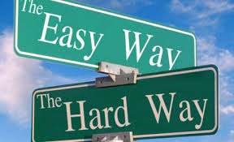
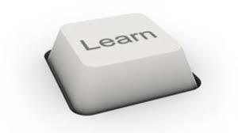
Yes, but…

Slide 5
There’s more to learn than you think…
Any time a person is in a new situation…
New country
New university
New baby
New job, etc.
There are things you don’t know…
Things you know that you don’t know
Things you don’t know that you don’t know

Slide 6
Things you know that you don’t know
Office hours in Bonner Hall: where is Bonner?
Can look it up on-line, can ask someone
Can estimate how long it will take to get this information
Can estimate how bad it will be if you don’t get this information

Slide 7
Things you don’t know that you don’t know…
Can not estimate how long it will take to get this information
No idea how bad it will be if you don’t get this information
You’re not aware that this item exists

Slide 8
New country…
Relian Kru arrives in Neraunce
White cravat, green breeches, blue ring…
Clothing colors very important
Has just given mortal insult to the Dhreve
Has the High Court Assassin after him for the rest of the book
This is why the U.S. Department of State has protocol officers…

Slide 9
Consider these examples of things I didn’t know…
New university
New baby
New job
How could the systems have worked to help me get the information?

Slide 10
How might I have gotten the info…
New university
New baby
New job
First Year Experience course for new grad students
Read book?
Talking with senior student
First Year Experience course for new parents?
Talking with Peer Group
Talking with senior person

Slide 11
Start to form a peer group
Name
Where you’re from
Academic interest
Non-academic interest
Some question you have about UCSD

Slide 12
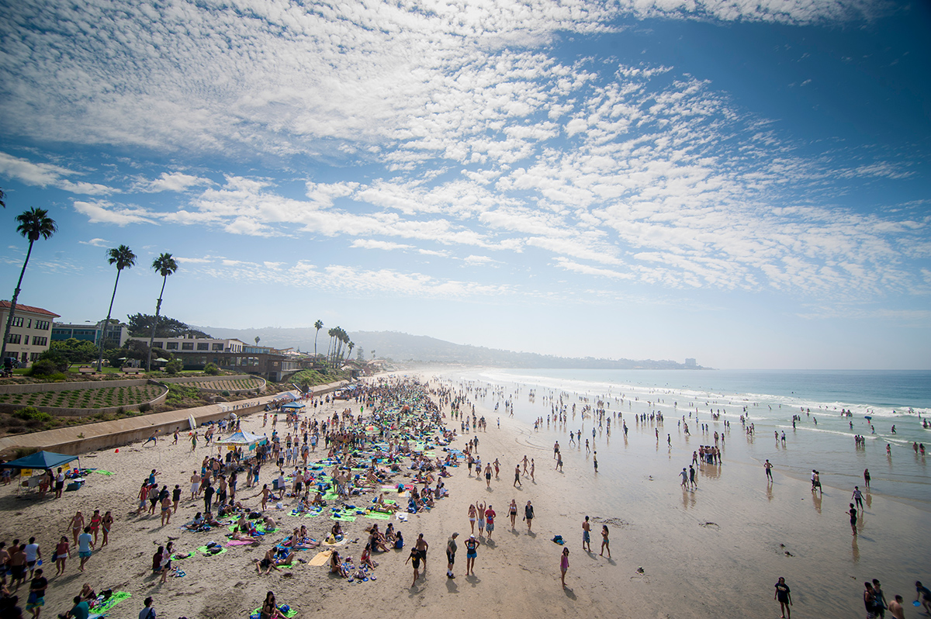
University Life
Opportunities, challenges, expectations

Slide 13
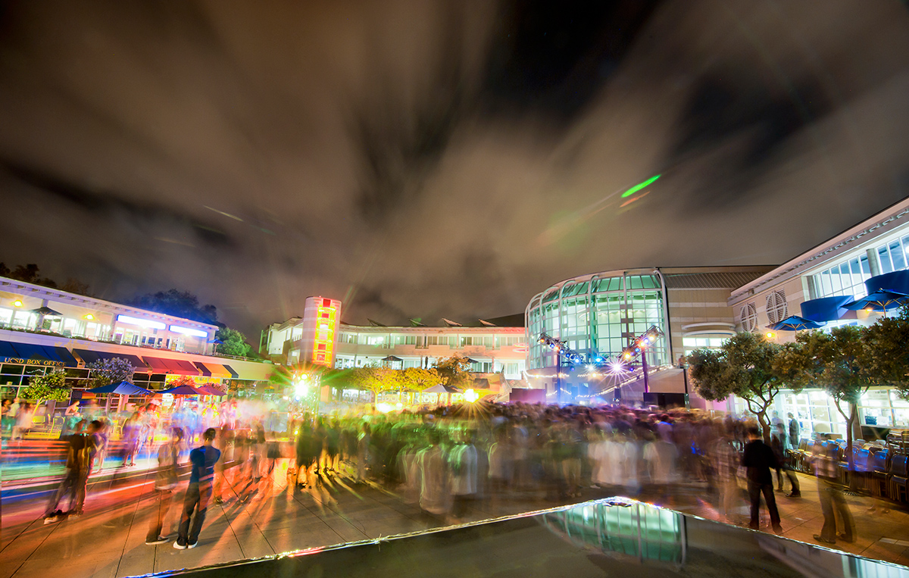
UCSD Community
Almost 60,000 people are affiliated with UCSD.
About half are students. Who are all the other people?

Slide 14
People at UC San Diego
Students
Staff
Faculty/Instructors
Undergraduates
Graduate students
Professional degree students (M.D., MBA, PharmD, etc)
Related to students: advising, housing…
Research staff
Medical Center
General (budget, power plant, etc.)
Professors
Clinical faculty
Lecturers
Adjuncts
etc.

Slide 15
The brutish life of a professor
Undergrad
4 years
Grad School
5-6 years
Assistant Professor
6 years
Associate Professor
(Full) Professor
Perhaps followed by post-doc (1-3 years)
Followed by TENURE DECISION!
6 years or more

Slide 16
What do professors do?
Research
“Publish or perish”
Impact: citations
Research funding
Teaching
Undergraduate and graduate classes
Service
Internal: Committees, administration of department, college, university
External: Public service, professional service (e.g., organizing conference)

Slide 17
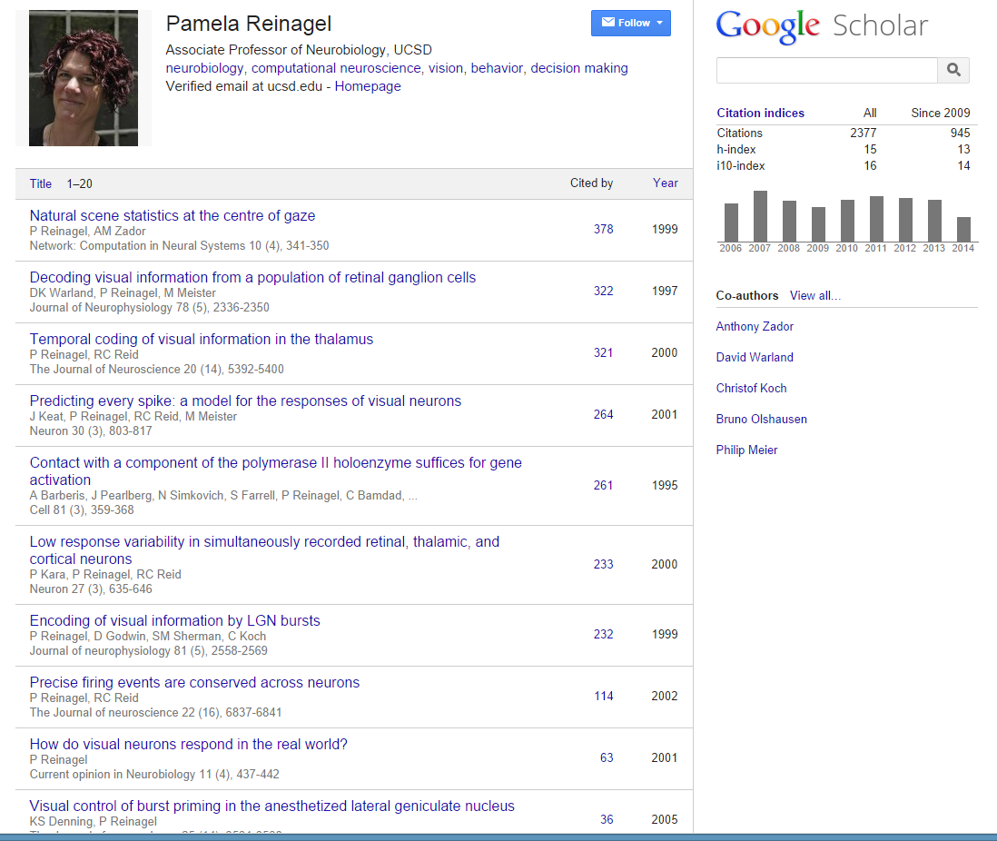
A research profile
Publications
Citations
Citations

Slide 18
As with any job, there are conflicting pressures…

Slide 20
And different constituencies view professors differently…

Slide 21
How students see professors:
How the administration sees professors:
How professors see themselves:
I am a teaching machine.
I bring in research $$$.
I am the Einstein of our time.
teacher
researcher
expert + great thinker
There is some truth in all of this: Professors play many different roles on campus.

Slide 22
So what is a “Lecturer”?
Lecturers usually have similar credentials to professors
Ph.D. or other degree, depending on field
Some lecturers hold permanent positions:
Like a professor, but focused on teaching
Often involved in research related to teaching
Some lecturers are external people brought in to teach 1 course
Usually not involved in research
Expert on subject matter
May not know much about UC San Diego

Slide 23
Why do I care about: Different levels and types of instructors?

Slide 24
(1) Use the correct form of address
Others: figure out Mr./Ms./Dr./First Name
Professor Smith
Staff
Students
Related to students: advising, housing…
Research staff
Medical Center
General (budget, power plant, etc.)
Undergraduates
Graduate students
Professional degree students (M.D., MBA, PharmD, etc)
Faculty/Instructors
Professors
Clinical faculty
Lecturers
Adjuncts
etc.
Teaching Assistants (TAs)
Dr. Smith
First Name OK

Slide 25
(2) Reference letters not all created equal
Two students apply to the Gordon Leadership Center to be Gordon Scholars
Professors
Assistant
Associate
Full
Clinical faculty
Lecturers
Adjuncts
etc.
Student B’s 2 letter writers
Graduate students
Professional degree students (M.D., MBA, PharmD, etc)
Teaching Assistants (TAs)
Student A’s 2 letter writers

Slide 26
(3) Different levels of teaching quality
Some faculty are excellent teachers
Others, not so much
Not really related to Assistant/Associate/Full distinction
LSOEs often good teachers, up-to-date on pedagogical techniques
Find out who the good ones are
Course and Professor Evaluations (CAPE)
Ask people who have had that instructor before
For courses which are optional, you can choose based on who’s a good teacher

Slide 27
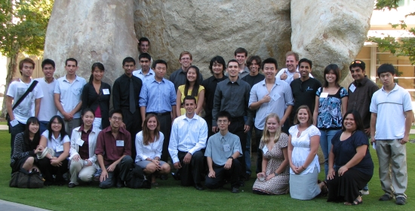
We have now seen the people at UCSD
Students
Staff
Teachers

Slide 28
Mission of UC San Diego
Education
Research
Public service
Undergraduates
Graduate students
Professional degree students (M.D., MBA, PharmD, etc)
Discover new knowledge
Create new works of art
Design and Invent new things
Medical Center
Inventions
Community outreach
Public policy
etc.

Slide 29
Who is involved in the educational mission?
Students
Staff
Faculty/Instructors
Undergraduates
Graduate students
Professional degree students (M.D., MBA, PharmD, etc)
Related to students: advising, housing…
Research staff
Medical Center
General (budget, power plant, etc.)
Professors
Clinical faculty
Lecturers
Adjuncts
etc.
Discussion Leaders
Readers
Teaching Assistants (TAs)
Learners
Teachers

Slide 30
Who is involved in the research mission?
Students
Staff
Faculty/Instructors
Undergraduates
Graduate students
Professional degree students (M.D., MBA, PharmD, etc)
Related to students: advising, housing…
Research staff
Medical Center
General (budget, power plant, etc.)
Professors
Clinical faculty
Lecturers
Adjuncts
etc.
some

Slide 31
Who is involved in the public service mission?
Staff
Students
Faculty/Instructors
Related to students: advising, housing…
Research staff
Medical Center
General (budget, power plant, etc.)
Professors
Clinical faculty
Lecturers
Adjuncts
etc.
Undergraduates
Graduate students
Professional degree students (M.D., MBA, PharmD, etc)
Everyone can be

Slide 32
I’m here for an education. Why do I care about the rest of the mission?

Slide 33
Why do I care about: Research Mission
Research Mission
About 4400 institutions of higher learning in the U.S.
About 5% are research universities
You are at one of them
Possible disadvantage:
For most professors, teaching is not #1 priority
Possible big advantages:
Learning from someone who is creating new knowledge in the field
Some undergrads do research
Find out from CAPE or from senior students who’s a good teacher
Join in! (week 9)

Slide 34
Why do I care about: Public Service Mission
Huge part of TMC
Many opportunities
Cynical point of view
Burnish resume for the future
Altruistic point of view
Make the world better
Other reasons
Make friends
Get academic credit
Learn about careers

Slide 35
NYT Article: The Fundamental Way that Universities are an Illusion
What do you think of the NYT article?
Is it realistic?
Are you concerned?
Is there something you need to do?

Slide 36
Reading:
Before your discussion section, read the other item (College Customs) posted for Week 1
Anything daunting there?
Anything exciting there?
Check the web site for what to read before Friday

Slide 37
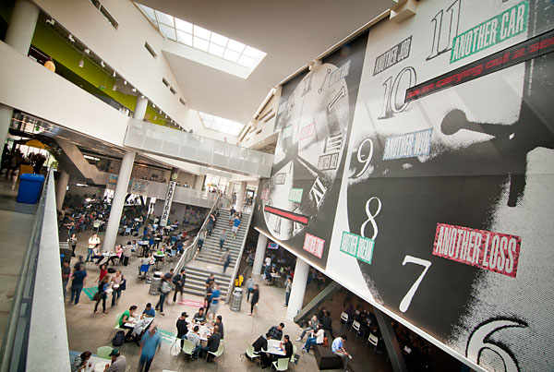
See you next week!

